Slide 1

JavaScript Applications
Course Overview
SoftUni Team
Technical Trainers
Software University
https://softuni.bg

Slide 2
Table of Contents
Introduction
Training & Team
Course Objectives
Course Organization

Slide 3
Have a Question?
sli.do
#js-advanced

Slide 4













SoftUni Diamond Partners

Slide 5


Educational Partners

Slide 6
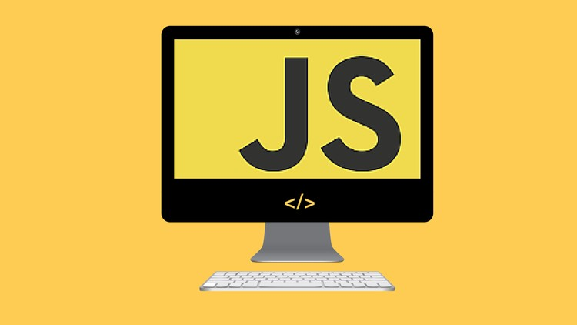
JS Applications
Course Objectives & Program

Slide 7
Course Objectives
Improve DOM skills with new techniques
Use remote services to read and store data
Work with external libraries and documentation
Apply best practices and project architecture
Create fully-featured front-end applications

Slide 8
JS Applications – Course Topics
HTTP and REST Services
Asynchronous Programming
Data and Authentication
Single Page Applications
Architecture and Testing

Slide 9
JS Applications – Course Topics
Client-Side Rendering
Routing
Modular Applications
End-to-End Application
Webpack

Slide 10

Trainers and Team

Slide 11
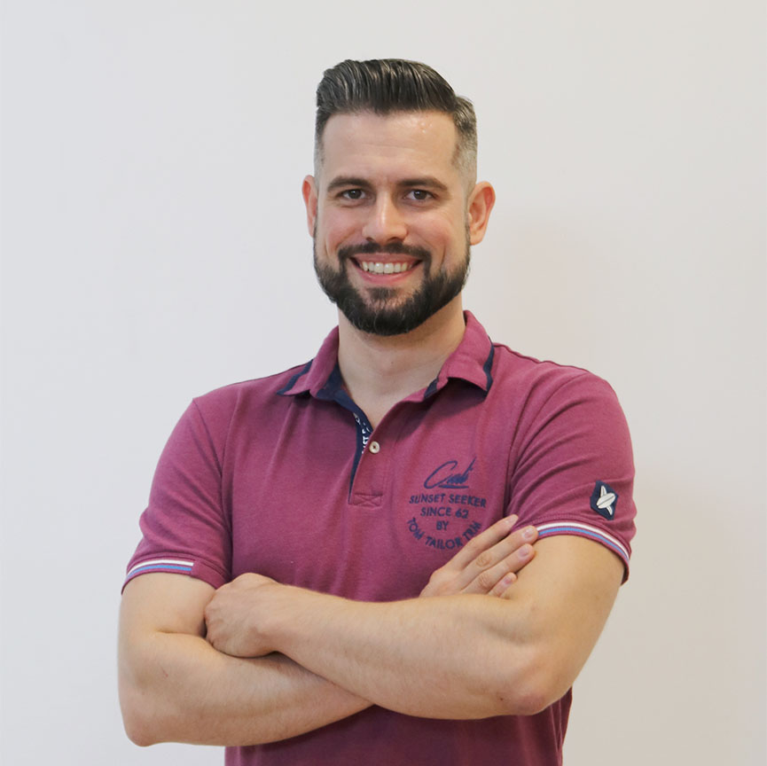
Ivaylo Papazov
Senior Full Stack Developer & Team Lead at Motion-Software
Trainer at SoftUni
Experience with JS, React, Node.js, MongoDB
6+ years professional experience

Slide 12
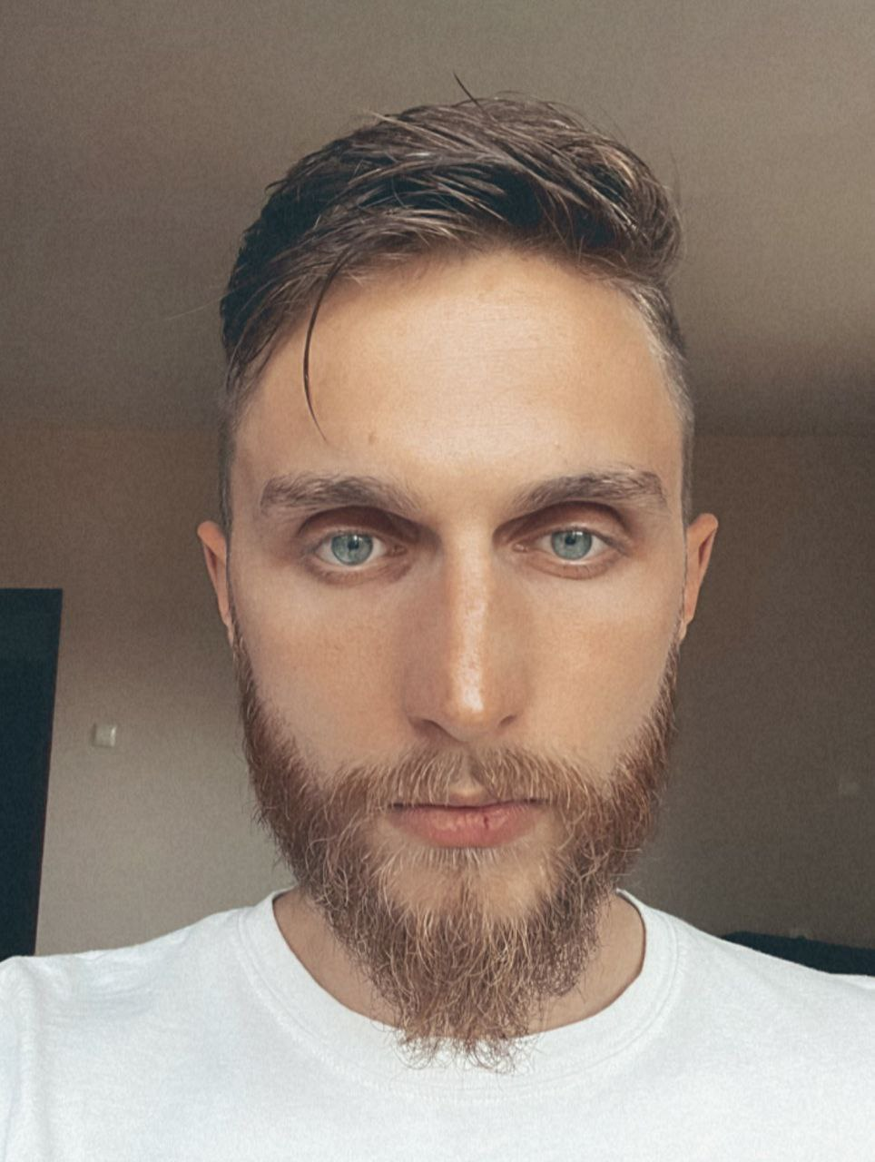
Ivaylo Dimitrov
Software Engineer at EPAM Systems
+4 years of experience as a Technical Trainer at Software University
Front-end development
Lecturer in various conferences and seminars

Slide 13

Course Details
Assessment and Schedule

Slide 14

Practical Exam
Structure: 1 problem for 4 hours
Single Page Application with multiple features
Use remote data storage
Implement user profiles
Libraries for templating and routing
Exam: 2 Apr 2022
Retake: 10 Apr 2022
Link to Exams

Slide 15
Theoretical Exam
20 questions for 30 minutes
Multiple-choice
English
Automated quiz system
Available online
You can submit your answers just one time

Slide 16
JS Advanced Module Timeline
COMPLETED
JS Advanced
Start: 11. Jan 2022
Exam: 19. Feb 2022
11.
19.
6 weeks
4 times per week
Jan
Feb
JS Applications
Start: 22. Feb 2022
Exam: 02. Apr 2022
22.
02.
6 weeks
4 times per week
Feb
March
Apr
Exam Retakes
JS Advanced: 06. Apr 2022
JS Applications: 10. Apr 2022
April

Slide 17
Course Scoring
Practice grade:
Theory grade:
SoftUni Certificate: 5.00 from Practice
CPE Certificate: 3.00 average from Practice + Theory
Practical Exam
Homework
100 %
+5 %
Theoretical Exam
100 %
17

Slide 18




Course Web Site, Forum and FB Group
Official web site:
Official discussion forum:
Official Facebook group:
Official SoftUni JavaScript Community:
softuni.bg/trainings/3589/js-applications-february-2022
softuni.bg/forum/categories/19/
facebook.com/groups/JSAdvancedSeptember2021
facebook.com/groups/SoftUniJavaScriptCommunity/

Slide 19
Questions?
Notes:
19

Slide 20
Trainings @ Software University (SoftUni)
Software University – High-Quality Education, Profession and Job for Software Developers
softuni.bg, softuni.org
Software University Foundation
softuni.foundation
Software University @ Facebook
facebook.com/SoftwareUniversity
Software University Forums
forum.softuni.bg
Notes:
20

Slide 21

License
This course (slides, examples, demos, exercises, homework, documents, videos and other assets) is copyrighted content
Unauthorized copy, reproduction or use is illegal
© SoftUni – https://about.softuni.bg/
© Software University – https://softuni.bg
Notes:
21

